Slide 1
CS4104
Applied Machine Learning
Lecture No 11
Supervised Classification - VI
(Generalization and Overfitting/Optimization)
Spring 2025
1

Slide 2
ARTIFICIAL NEURAL NETWORKS
Generalization and Over-fitting

Slide 3
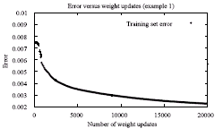
ARTIFICIAL NEURAL NETWORKS
Generalization & Overfitting
Overfitting: When to terminate the training of a network?
The obvious choice is to stop, when the error falls below a certain threshold
or
when it stops reducing significantly (reaches a plateau)

Slide 4
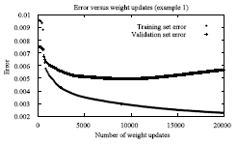
ARTIFICIAL NEURAL NETWORKS
Generalization & Overfitting
This is a poor strategy because backpropagation tends to over-fit the training examples in its effort to reduce the error
The NN memorizes the training patterns & this results in a loss of the ability to generalize

Slide 5
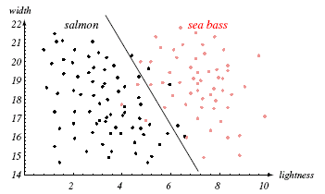
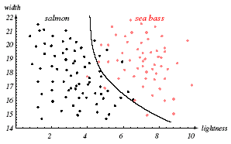
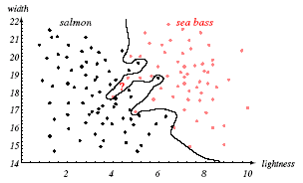
ARTIFICIAL NEURAL NETWORKS
Generalization & Overfitting

Slide 6
ARTIFICIAL NEURAL NETWORKS
Generalization & Overfitting
How to overcome the overfitting problem?
Remedies for overfitting include optimizing the network architecture and using enough training patterns
Another approach is to detect the point of overfitting by a set called validation set
For this purpose, the original data set is divided into three disjoint sets: training set, generalization set, and validation set

Slide 7
ARTIFICIAL NEURAL NETWORKS
Generalization & Overfitting
Train on the training set but monitor the performance on the validation set
Save the weights after every few iterations
The weights corresponding to the lowest error on the validation set should be used as the final weights

Slide 8
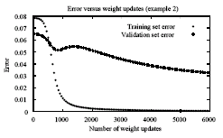
ARTIFICIAL NEURAL NETWORKS
Generalization & Overfitting
Attention: Validation error can sometimes increase and then reduce again

Slide 9
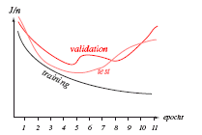
ARTIFICIAL NEURAL NETWORKS
Generalization & Overfitting
An example: Training set error, validation set error and test set error

Slide 10
ARTIFICIAL NEURAL NETWORKS
Data Preparation

Slide 11
ARTIFICIAL NEURAL NETWORKS
Data Preparation
One of the most important phases in using a NN is to collect and transform data into a form acceptable to the NN
The first step is to decide on the inputs and the outputs. Obviously irrelevant inputs should be excluded
The second step is to process the data in order to
  remove the outliers,
  handle missing data,
  transform non-numeric data to numeric, and
  to scale the data into the active range of the activation function used

Slide 12
ARTIFICIAL NEURAL NETWORKS
Data Preparation: Missing Values
For missing values in the input, the following options exists:
  Remove the entire pattern
  Replace each missing value with the average value (continuous value case) or the most frequently occurring value (discrete value case)
  For each input parameter that has a missing value, add an additional input unit to indicate patterns for which that parameter is missing. It can then be determined after training (by analyzing the weights on the links going out from that unit) whether the missing values had a significant influence on the network

Slide 13
ARTIFICIAL NEURAL NETWORKS
Data Preparation: Coding of Nominal Input Values
All input values to a NN must be numeric. Nominal values therefore need to be transformed to numerical values
A nominal input parameter that has n different values is coded as n different binary input parameters, where the input parameter that corresponds to a nominal value has the value 1, and the rest of these parameters have the value zero
Example: Apple Input x1 x2 x3
Red 1 0 0
Green 0 1 0
Yellow 0 0 1

Slide 14
ARTIFICIAL NEURAL NETWORKS
Data Preparation: Coding of Nominal Input Values
An alternative is to use just one input parameter and to map each nominal value into an equivalent numerical value. This is, however, not a good idea, since the NN will interpret the input parameter as having continuous values, thereby losing the discrete characteristic of the original data
Example: Apple Input x
Red 1
Green 2
Yellow 3

Slide 15
ARTIFICIAL NEURAL NETWORKS
Data Preparation: Input Output Scaling
It is useful to scale the input values to the active range (e.g. -1, 1) and domain (e.g. -3^{1/2}, 3^{1/2} for hyperbolic tangent) of the activation function used
Output values have to be scaled to the active range of the activation function

Slide 16
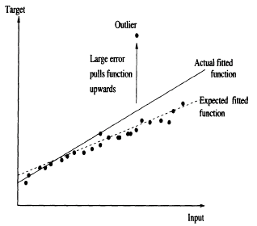
ARTIFICIAL NEURAL NETWORKS
Data Preparation: Outliers
Outliers have severe effects on accuracy, because they result in large errors, and consequently large weight updates.
The learned function is pulled towards the outliers in an attempt to reduce the training error

Slide 17
ARTIFICIAL NEURAL NETWORKS
Data Preparation: Outliers
Solution:
Remove outliers before the start of the training, using statistical techniques.
This method has the risk of eliminating important information about the data (either the outlier may be a genuine pattern, or only one parameter in the outlier may be erroneous and the other parameter values may be correct and precious)

Slide 18

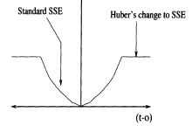
ARTIFICIAL NEURAL NETWORKS
Data Preparation: Outliers
Solution:
Use a robust error function
that is not influenced by outliers
An example is the Huber function,
shown in the figure
Patterns for which the error is larger than |α| have a constant value, and have zero influence when weights are updated (the derivative of a constant is zero)

Slide 19
ARTIFICIAL NEURAL NETWORKS
Data Preparation: Noise Injection
For problems with a limited number of training patterns, controlled injection of noise helps to generate new training patterns
It has been observed that addition of noise results in reduced training time and increased accuracy

Slide 20
ARTIFICIAL NEURAL NETWORKS
Data Preparation: Training Set Presentation Order
It is usually helpful to control the order in which the training patterns are presented for learning
If there are three classes present, it is desirable to have pattern of one class, followed by another, followed by third
If all the patterns of a class are grouped together, the network will learn very slowly or not at all
Similarly, depending upon the problem, other manipulations may be done: e.g. reduction of training patterns bunching together in the space

Slide 21
ARTIFICIAL NEURAL NETWORKS
Data Preparation: Training Set Size
Rule of thumb has been proposed
P = W/e provided training accuracy is 1 – 0.5e
Where P = number of training patterns required
W = number of weights to be trained
1 - e = classification accuracy expected
Example: If e = 0.1, W = 80 then P = 80/(0.1) = 800 patterns
are required if we want to assure 90% testing accuracy (the net has to be trained to classify 95% of training patterns correctly)

Slide 22
ARTIFICIAL NEURAL NETWORKS
References
Section 7.1.1of Engelbrecht’s book
Page 305 Fausette (Momentum)
Chapter 6 Fausette
Chapter 7 Engelbrecht

